Slide 1

BUSINESS
REVIEWS

Slide 2

Harnessing the Power of Data
Imagine a world where your favorite streaming platform knows exactly what you want to watch before you even search. Or where online retailers predict your next purchase with uncanny accuracy.
This is the reality of recommendation systems, powerful tools that leverage data to personalize user experiences.

Slide 3

Data Engineering - The Hidden Engine of Recommendation Systems
Building a successful recommendation system goes beyond collecting data and applying algorithms.
Data engineering serves as the hidden powerhouse, meticulously transforming data into insightful recommendations.

Slide 4

Impact of Recommendation Systems:
Increased User Engagement
Improved Sales and Conversions
Enhanced Decision-Making

Slide 5

Business Reviews Case Study
Yelp Business Review Data Pipeline
C2 General

Slide 6


Agenda
1
C2 General

Slide 7
Agenda
1
2
Overview
C2 General

Slide 8
Agenda
1
2
Key Components
Overview
C2 General

Slide 9
Agenda
1
2
3
Key Components
Overview
C2 General

Slide 10
Agenda
1
2
3
Key Components
Overview
Challenges
&
Benefits
C2 General

Slide 11
Agenda
1
2
3
4
Key Components
Overview
Challenges
&
Benefits
C2 General

Slide 12
Agenda
1
2
3
4
Key Components
Overview
Challenges
&
Benefits
Demo
C2 General

Slide 13

Project Overview
Process and analyze Yelp business review data to gain insights into customer sentiment, business performance, and industry trends.
Technology Stack:
Python
Kafka
AWS services (DynamoDB, S3, Redshift)
PySpark
AWS Lambda
Power BI
C2 General

Slide 14









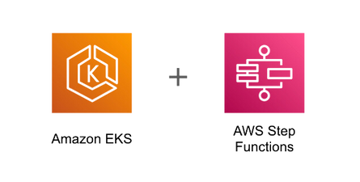

Project Pipeline
Data Source
Data Ingestion & Preparation
Data Staging
Data Processing
Data Warehouse
Data Visulization
AWS Account
CDC
Business Review
App Simulation
(Consumer)
DynamoDB
AWS S3 -
Daily Changes
Redshift
(Producer)
Data Orchestration & Monitoring

Slide 15

Data Sources
The primary data sources for the project were three key tables from Yelp's dataset :
Business.csv (150,346 businesses )
Contains business data including location data, attributes, and categories. We take all records.
Review.json (6,990,280 reviews )
Contains full review text data including the user_id that wrote the review and the business_id the review is written for. We take 6M of records.
User.csv (1,987,897 users)
User data including the user's friend mapping and all the metadata associated with the user. We take 1M of records.
C2 General

Slide 16


Streaming Producer
Read the file by Python
C2 General

Slide 17
Streaming Producer
Read the file by Python
Convert the DataFrame to a list of dictionaries
C2 General

Slide 18
Streaming Producer
Read the file by Python
Convert the DataFrame to a list of dictionaries
Send the records in loop to Kafka topics
C2 General

Slide 19
Streaming Producer
Read the file by Python
Convert the DataFrame to a list of dictionaries
Send the records in loop to Kafka topics
Wait one second to send the next record
C2 General

Slide 20
Streaming Engine
Kafka, a distributed streaming platform, revolutionizes real-time data processing and communication.

Slide 21
Streaming Engine
Kafka, a distributed streaming platform, revolutionizes real-time data processing and communication.
Key Features (Scalability, High Throughput)

Slide 22
Streaming Engine
Kafka, a distributed streaming platform, revolutionizes real-time data processing and communication.
Key Features (Scalability, High Throughput)
Use Cases: (Real-Time Analytics,Event Sourcing )

Slide 23

Streaming Consumer
The Kafka consumer, implemented using PySpark
C2 General

Slide 24
Streaming Consumer
The Kafka consumer, implemented using PySpark
Decodes the data and parses it as JSON
C2 General

Slide 25
Streaming Consumer
The Kafka consumer, implemented using PySpark
Decodes the data and parses it as JSON
Processed and transformed incoming data.
C2 General

Slide 26
Streaming Consumer
The Kafka consumer, implemented using PySpark
Decodes the data and parses it as JSON
Processed and transformed incoming data.
PySpark jobs enriched the data and prepared it for storage in DynamoDB.
C2 General

Slide 27
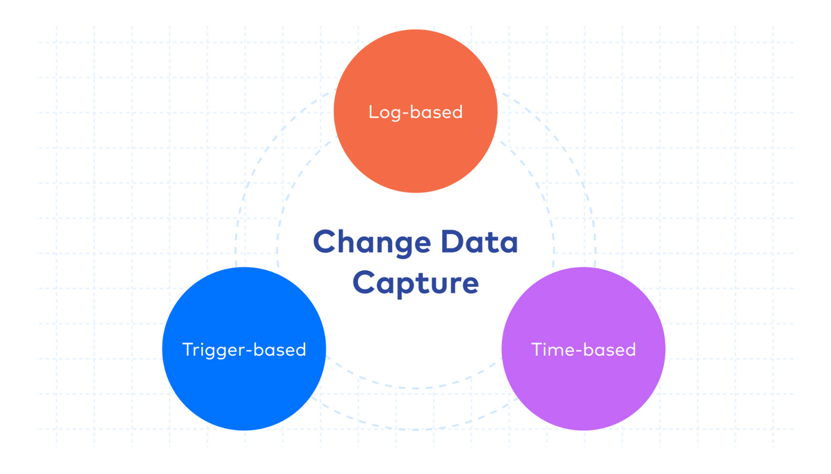
Change Data Capture (CDC)

Slide 28

DynamoDB Tables
DynamoDB was used as a NoSQL database for real-time storage of processed Yelp data.
C2 General

Slide 29
DynamoDB Tables
DynamoDB was used as a NoSQL database for real-time storage of processed Yelp data.
AWS Lambda Triggers in DynamoDB were configured to capture changes in the data, enabling CDC.
C2 General

Slide 30

AWS Lambda Triggers
Lambda functions were implemented to trigger CDC processes in DynamoDB whenever changes occurred in the data.
C2 General

Slide 31
AWS Lambda Triggers
Lambda functions were implemented to trigger CDC processes in DynamoDB whenever changes occurred in the data.
These triggers captured and propagated changes to an S3 bucket for daily batch processing.
C2 General

Slide 32

S3 Batch Processing
Daily batch processing was performed on the data stored in S3 to aggregate, clean, and transform the data.
C2 General

Slide 33
S3 Batch Processing
Daily batch processing was performed on the data stored in S3 to aggregate, clean, and transform the data.
This processed data was then made ready for loading into the Redshift data warehouse.
C2 General

Slide 34

AWS RedShift
AWS Redshift served as the central data warehouse for storing the Yelp data in a structured and optimized format.
C2 General

Slide 35
AWS RedShift
AWS Redshift served as the central data warehouse for storing the Yelp data in a structured and optimized format.
Daily batches of processed data from S3 were loaded into Redshift for analytical queries.
C2 General

Slide 36

Analytical Dashboard
Power BI was utilized for data visualization, creating interactive dashboards and reports.
C2 General

Slide 37
Analytical Dashboard
Power BI was utilized for data visualization, creating interactive dashboards and reports.
Direct queries were made to Redshift to pull the latest data for analytical visualization and analysis.
C2 General

Slide 38
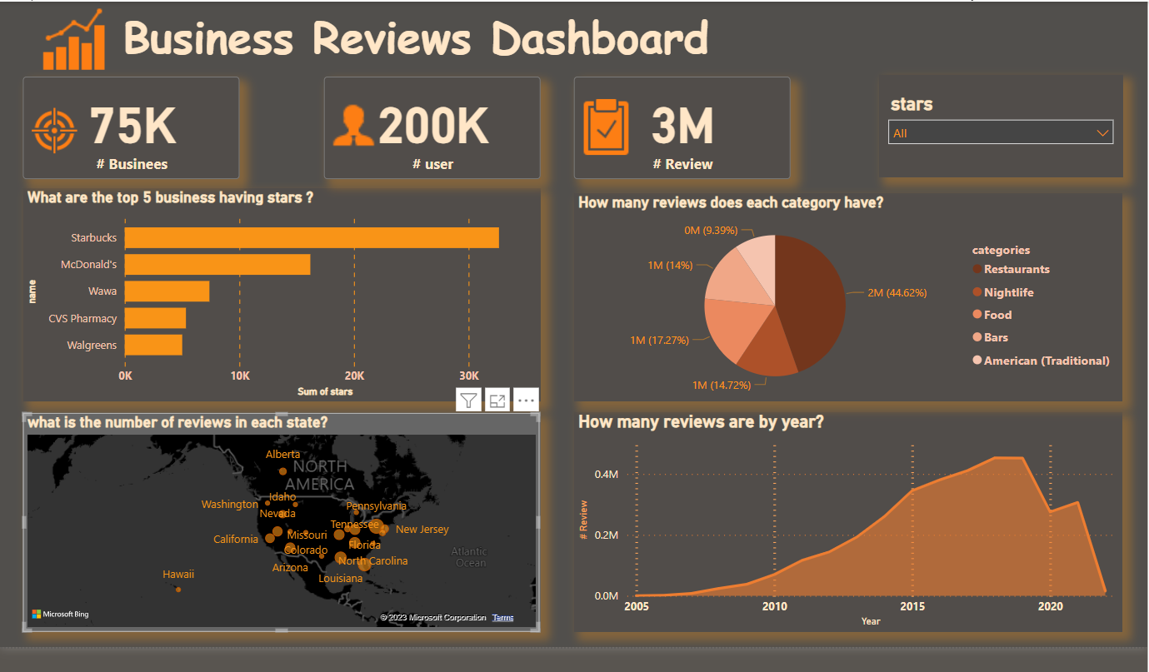

Slide 39

Analytical Data Insights
Daily Batch Processing
Flexible
Benefits
Scalable
Data Visualization
Change Data Capture
C2 General

Slide 40

Challenges
AWS Account:
Any holder of prepaid payment cards bearing the logos of Visa or Mastercard for electronic payments will be ineffective for use outside.
Service Dependencies:
Services like Kafka have dependencies on other services (e.g., Zookeeper for Kafka)
Spark Dependencies:
Ensuring all required JARs are available and compatible is essential for Spark's streaming job. Missing or incompatible JARs can lead to job failures.
Configuration Challenges:
Ensuring environment variables and configurations are correctly set can be tricky.

Slide 41
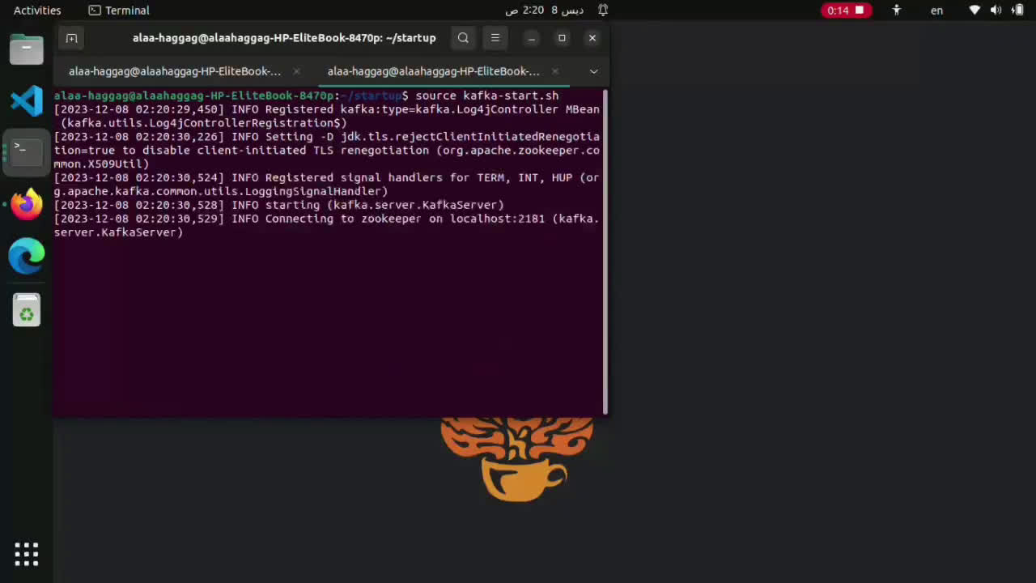
Project Demo
C2 General

Slide 42


Thank You!
Any Questions?
C2 General

